Slide 1
Data Scientist Salary Prediction
Name: Ajinkya Kulkarni

Slide 2
Problem Statement :
In todays ERA demand of Data Science field is growing day by day. As a student and also professional employees are choosing their career in this sector.
Everyone fresher or experienced person always have question that how's the data science field and what is starting package for fresher as well as for experienced one.
In this project I am predicting data scientist salary by using different features like age, company and revenue of company and relevant skills and many more. It’s a supervised learning regression project.

Slide 3
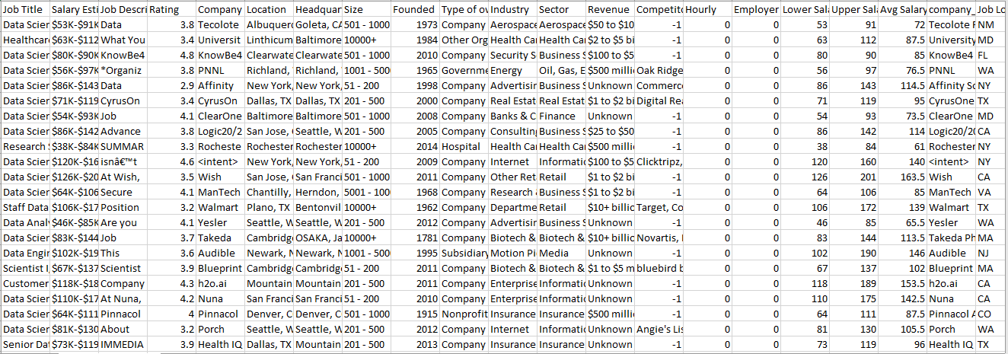
Dataset

Slide 4
Tasks:
Problem:
Regression problem
Dataset details:
742 Observations, 41 Independent Features, “Avg Salary(K)” Target variable
Mainly Tasks done in EDA:
Handling “-1” values
There are two columns with same details Like “Company Name” and “company_txt” and “Location” and “Job Location”.
Handling outliers in “Age” column
Handle multicollinearity between features
Checking Distribution of different features.

Slide 5
Data Cleaning Steps
Handling “-1” values and Replace with them nulls and replace them according to feature distribution or Dtype
Checking summary statistic of numeric feature
Checking and handling Outliers
Analysis of relation with target variable
Analysis of different features and taking out insights
Check correlation between features
Drop unnecessary columns
Separate Numeric and Categorical features
Create dummy variable of categorical features

Slide 6
Insights taken out from analysis
Average lower salary is about 75 K pa. We see 75% of the jobs positing has minimum salary =< than 91K pa, so it doesn't look like the mean value is affected much by the outlier(15K or 202K pa).
Average maximum salary is around 128K pa. We see 75% of the jobs positing has maximum salary =< than 155K pa, so it doesn't look like the mean value is affected much by the outlier(16K or 306K pa).
Mean Avg. salary is about 101K pa.
It looks like Python and SQL are the top skills in demand for Data Scientists, Data Engineers, analyst and Machine Learning Engineers. Excel is also a good skill to have for many of the jobs listed.

Slide 7
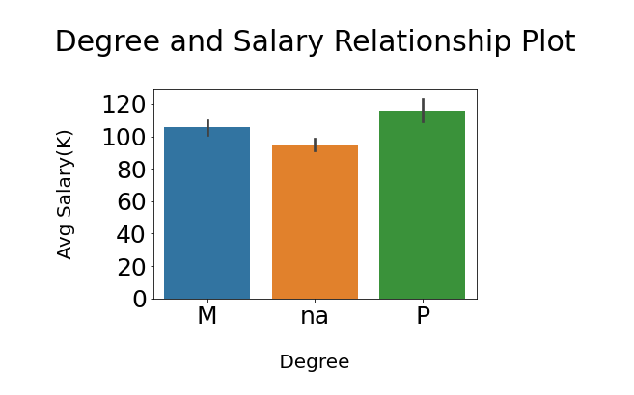
Insights taken out from analysis
Between analysis of “Degree” and “Avg Salary(K)” column we get to know that highest salary will be given to PHD holders

Slide 8
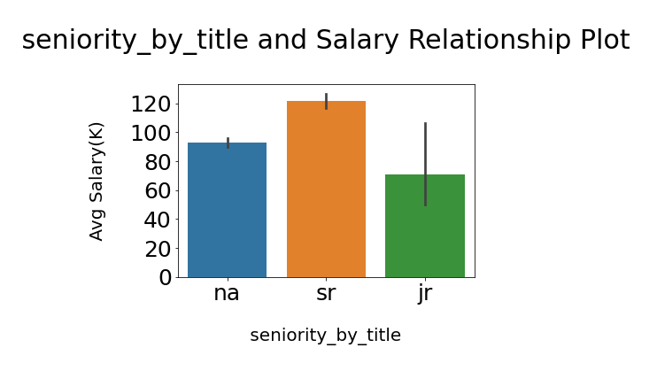
Insights taken out from analysis
Between analysis of “seniority_by_title” and “Avg Salary(K)” column we get to know that highest salary will be given to senior persons.

Slide 9
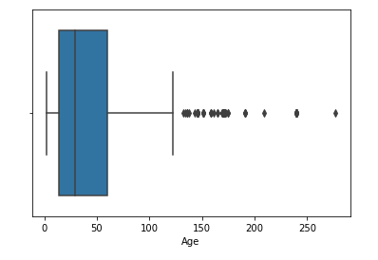
Insights taken out from analysis
In “Age” column above 100 value all are outliers.

Slide 10
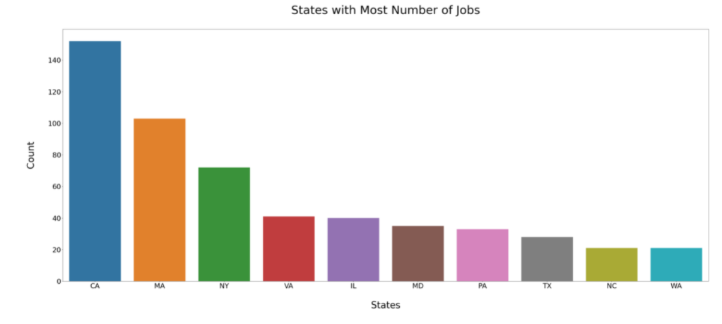
Insights taken out from analysis

Slide 11
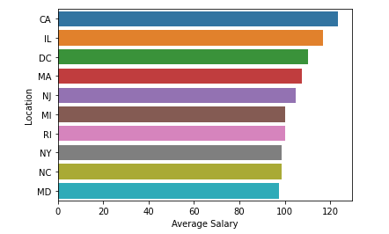
Insights taken out from analysis
Highest “Avg Salary(K)” with mean of state values highest Average salary in California state.

Slide 12
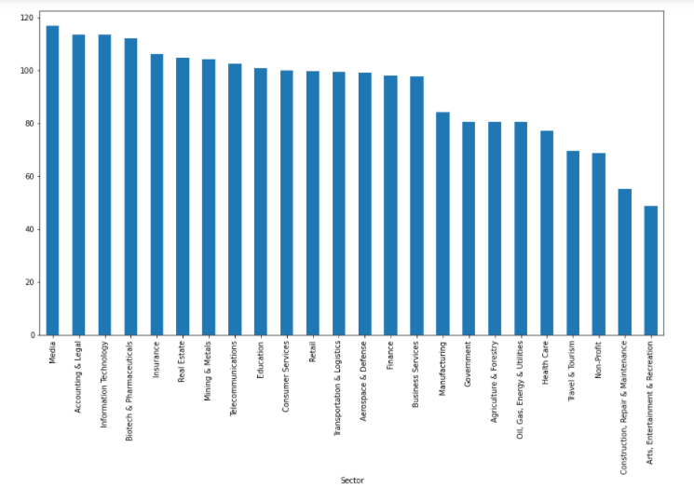
Insights taken out from analysis

Slide 13
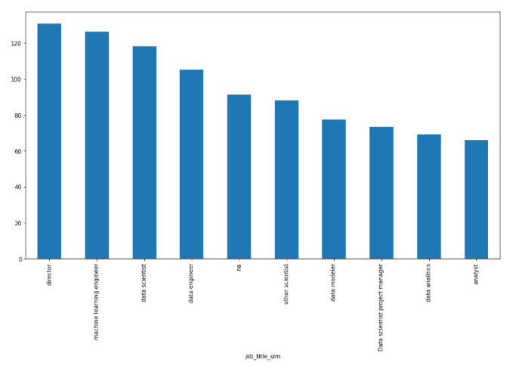
Insights taken out from analysis

Slide 14
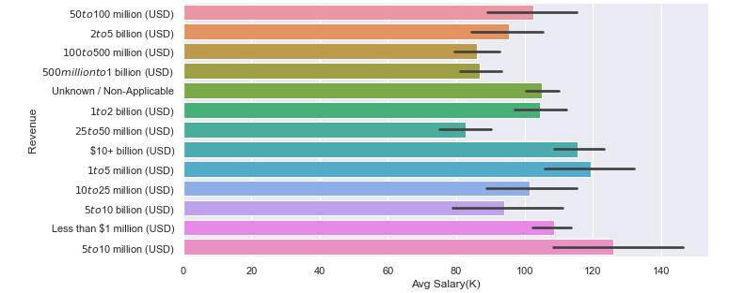
Insights taken out from analysis

Slide 15
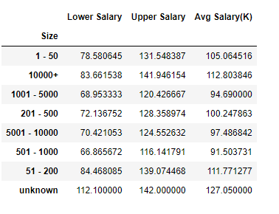
Insights taken out from analysis

Slide 16
Models Performed

Slide 17
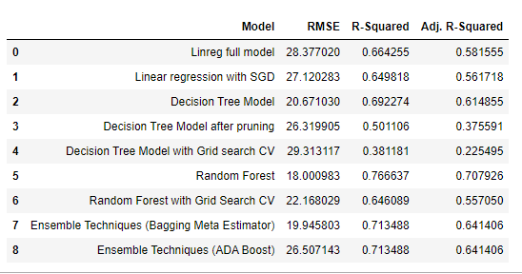
1. OLS 2. LR with SGD 3. Decision Tree 3.1Decision Tree with pruning 3.2 Decision Tree with grid search CV 4. Random Forest 4.1 Random Forest with grid search CV 5. Ensemble Techniques (Bagging Meta Estimator) 5.1 ADA Boost

Slide 18
Problems Faced:
Handling outliers in “Age” column as there are many values less than 14 and greater than 67. As 14 is standard working age and 67 is retired age in US.
Replace value with some conditions based upon column on particular row.
How to do regressor with Decision Tree, Ensemble Techniques and SVM and Naive Bays.

Slide 19
Thank You

